Slide 1

DBMS Sessional (CSE - 222)
Project database presentation
Project topic : Virtual Classroom
Project title : Edu-Sphere
Team members :
Name | ID
MD. Shahariar Alif | CSE - 02707425
Arafat Shahriyar Tuhin | CSE - 02707429
Koushik Dey Anik | CSE - 02707447
Shanta Chandra Nath | CSE - 02707452

Slide 2
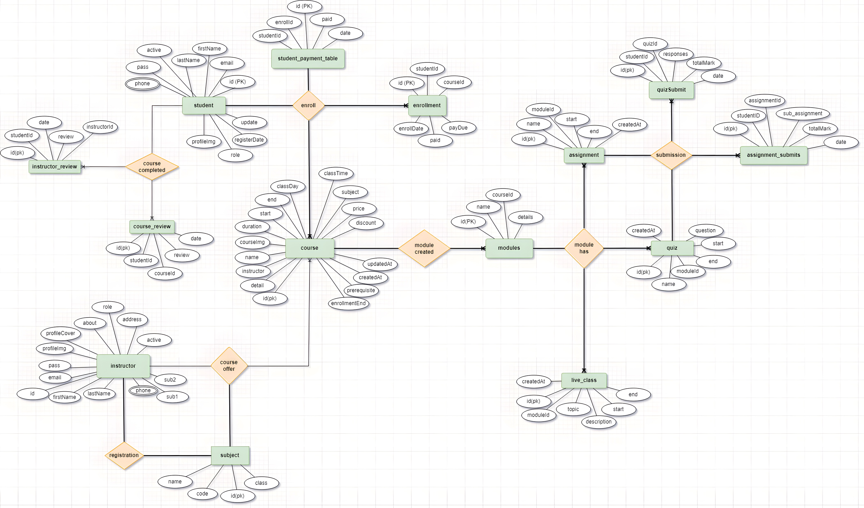

Slide 8
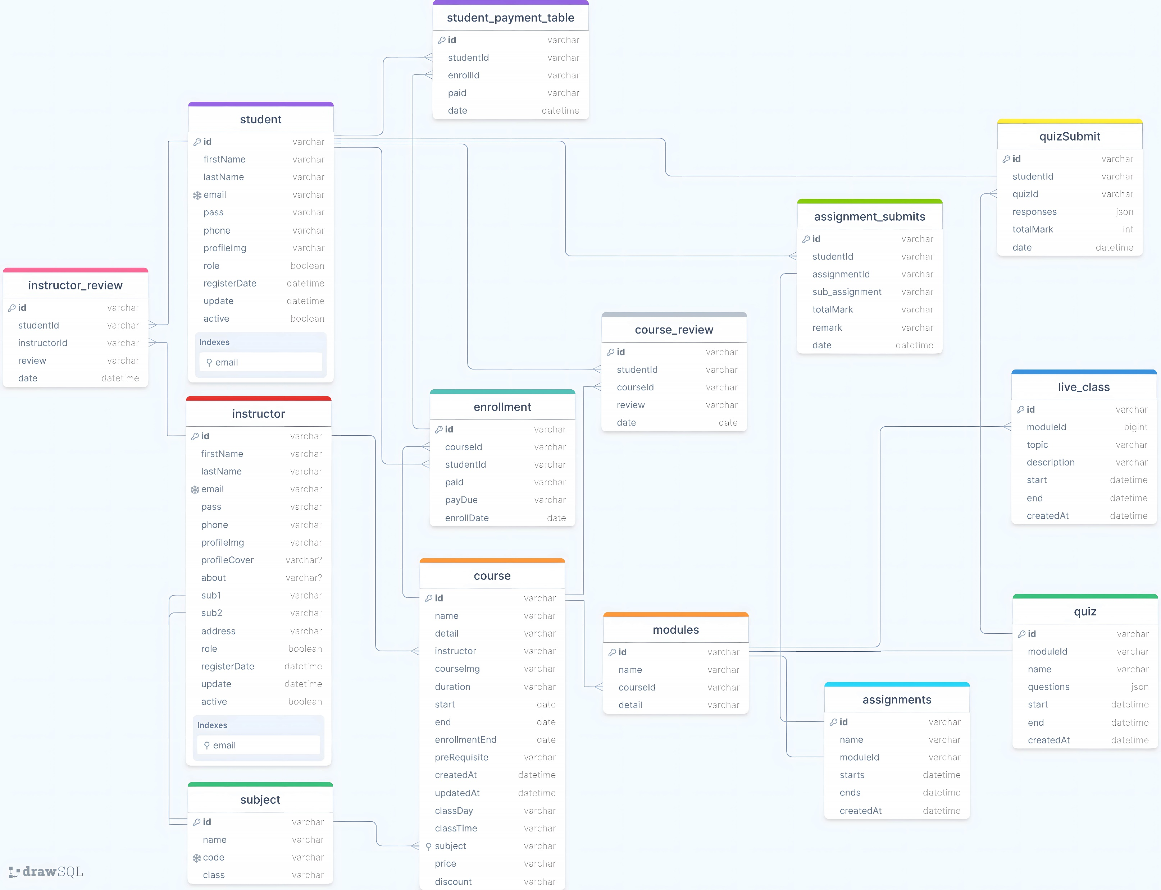

Slide 10
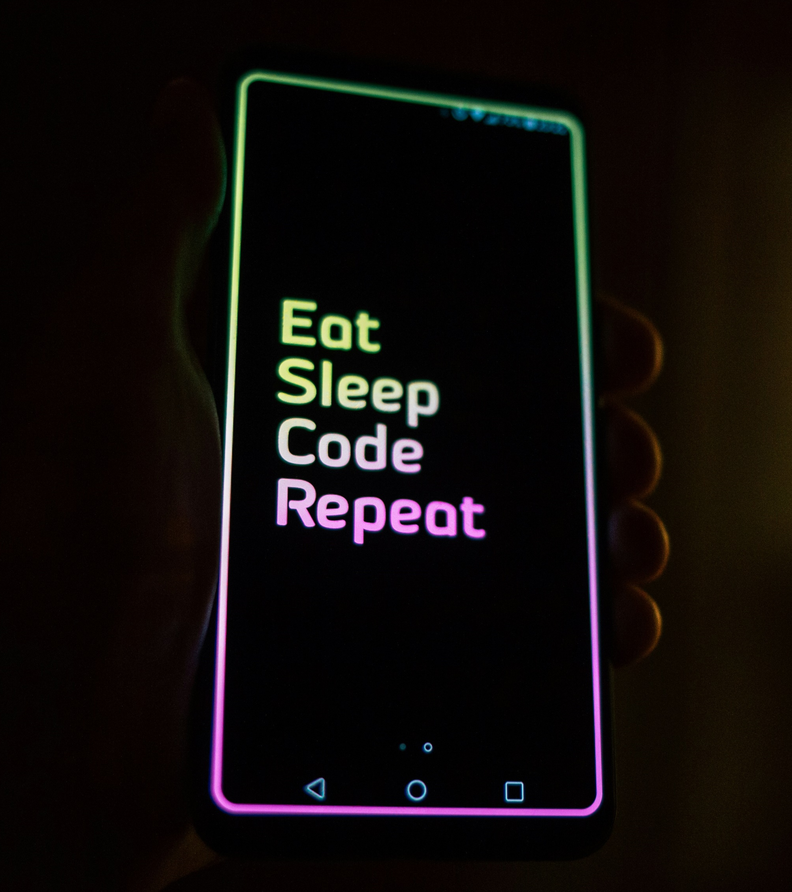
This concludes our presentation
Thanks to everyone

